Slide 1
BCG TechHack : Team 7
Saurabh Annadate and Tanya Tandon

Slide 2
PowerCo intents to reduce churn rate for SME enterprises..
PROBEM: Recent liberalization of the energy market in europe is inducing a more intense competition between energy providers
MISSION: BCG has identified the drivers of the problem and will be suggesting a strategy to counter it.
APPROACH:
We first identified the features that were the cause of major churns.
We build and fit a predictive model to assess potential churning customers and have suggested a strategy based on our findings.
We used historical data and logistic regression for our findings.

Slide 3
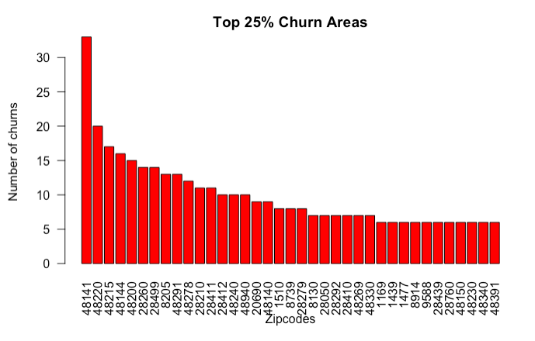
25% of churning clients are present in 37 zip codes..
50% of the churning clients are from Biscay province of Spain
We have clients in 5,344 Zipcodes

Slide 4
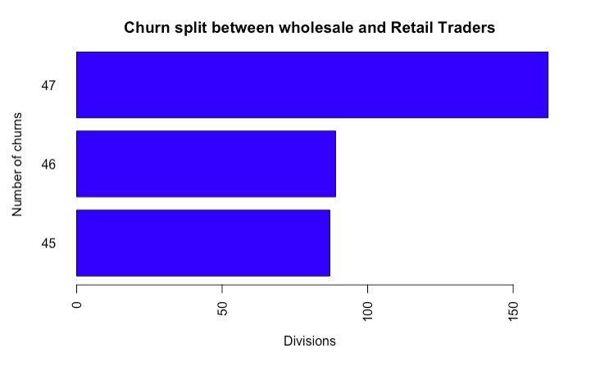
~ 25% churns happen in Wholesale and Retail Traders ( G ISIC code )
47: Wholesale and retail trade and repair of motor vehicles and motorcycles
48: Wholesale trade, except of motor vehicles and motorcycles
49: Retail trade, except of motor vehicles and motorcycles

Slide 5
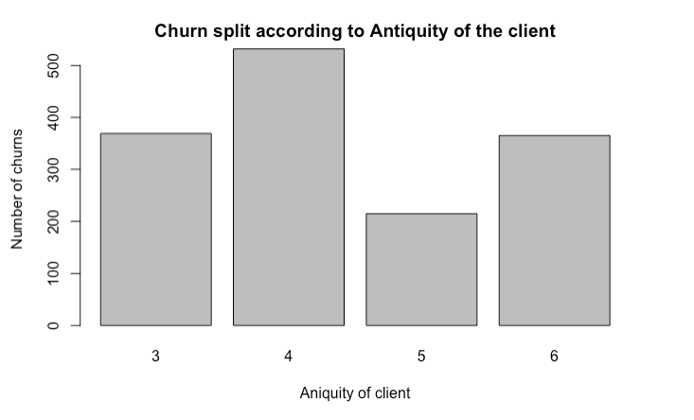
93 % churns happen for companies between 3-6 year old companies

Slide 6
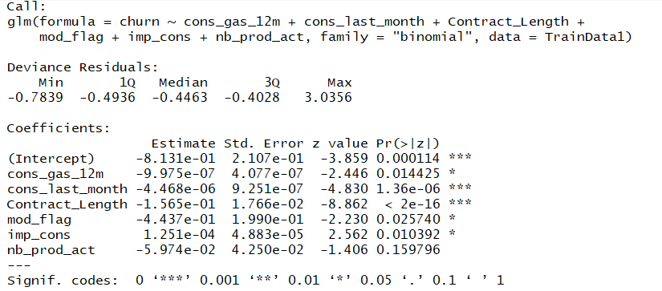
A Simple Logistic Regression was used to model the probability of a customer to churn

Slide 7
Our Model confirms..
Cons_gas_12m
The higher the gas consumption of an SME enterprise in the last year the less likely they are to churn
Cons_last month
The higher the gas consumption of an SME enterprise in the last
month the less likely they are to churn
Contract_length
The longer the contract length of an SME enterprise the less
likely they are to churn
mod_flag
If an SME enterprise's contract was modified they are less likely to churn
imp_cons
SME enterprises with higher consumptions are less likely to churn
nb_prod_act
The more the number of products a SME own, the less likely they are to churn

Slide 8
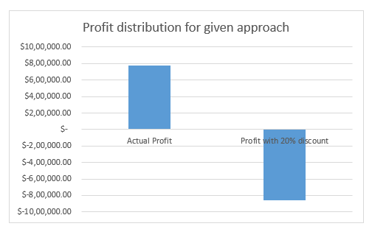
Our Analysis Confirms that offering a 20% discount to customers is not feasible to earn a profit
Assumptions:
Total net margin data given used as the profit
Profit % used as 10% for all customers (source: https://www.investopedia.com/ask/answers/011915/what-average-profit-margin-utility-company.asp)
Actual Profit = Predicted probability of retention * net Margin
Profit with 30% discount = Sum of Revenue * 0.8 - cost

Slide 9
Our recommendations
Power Co needs a variable pricing model pricing which linearly decreases price of energy and power per unit when a longer contract is signed.
Power Co needs to focus on retaining clients from SME enterprises which have less number of products and have antiquity between 3-6 years.
Power Co needs to target on acquiring market for SME enterprises that have higher number of products and services and a higher average power consumption.
Power Co should inspect their clients based out of Biscay province and wholesale and retail traders.

Slide 10
Further Analyses
Following additional analyses could be conducted to evaluate the problem further:
Evaluate ROI from different variable price modeling and discount combinations
Construct Clusters for churning clients

